Slide 1
Aligning Event Logs and Process Models for Multi-perspective Conformance Checking: An Approach Based on ILP
Massimiliano de Leoni
Wil M. P. van der Aalst

Slide 2
Conformance Checking
event stream
extract
conformance
✓/✗
event log
solved for control-flow
unsolved for other perspectives
A
B
model
DB

Slide 3

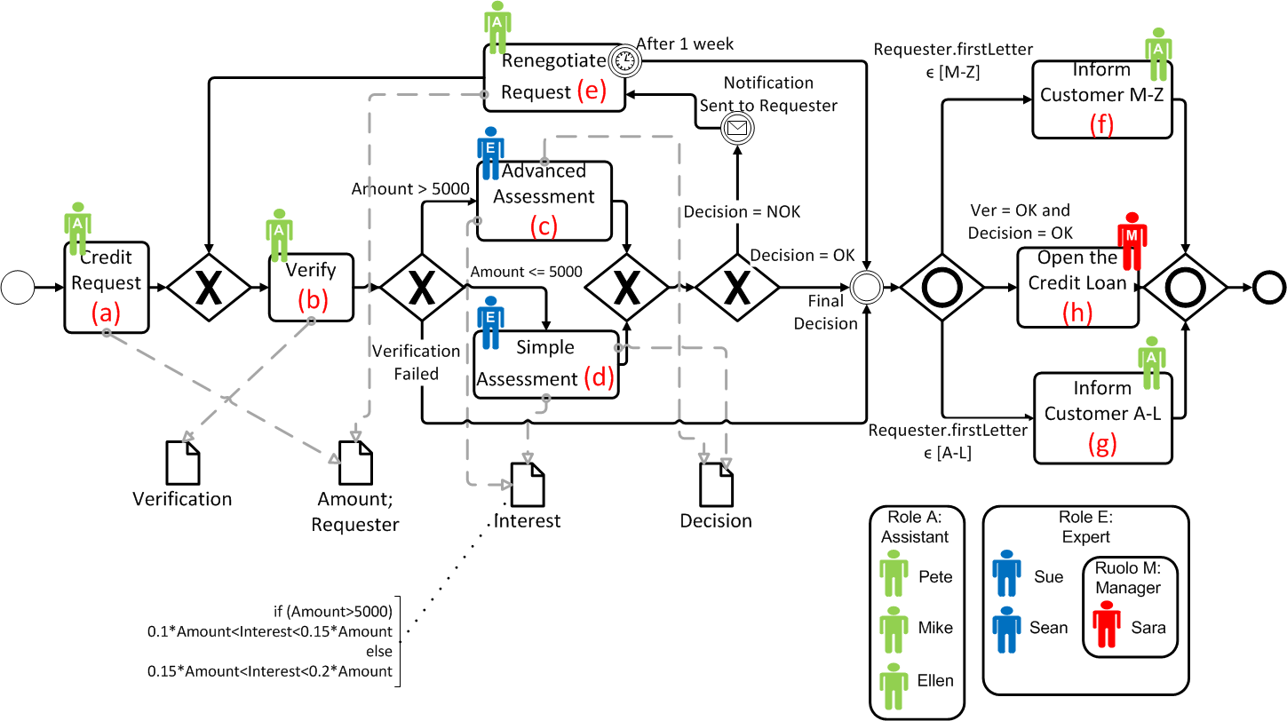
Example: A Credit Institute
Activity d should have occurred, since amount<5000
(a; {A = 3000;R = Michael; E = Pete});
(b; {V = OK;E = Sue});
(c; {I = 530;D = OK;E = Sue});
(f; {E = Pete});
Activity h hasn’t been executed: D cannot be OK
(a; {A = 3000;R = Michael; E = Pete});
(b; {V = OK;E = Pete});
(c; {I = 530;D = OK;E = Sue});
(d, {I = 599; D = NOK; E = Sue});
(f; {E = Pete});
For such a credit amount, should be interest <450
«Sue» not authorized to perform b: is not Assistant
(a; {A = 5001;R = Michael; E = Pete});
(b; {V = OK;E = Pete});
(c; {I = 530;D = NOK;E = Sue});
(f; {E = Pete});

Slide 4
Petri Nets with Data
y >= x+z
E
X
x < 10 and y’ >= y
Z
B
y <= x+z
S
A
F
Y
C
x >= 10 and y’ >= y

Slide 5
A trace without problems
S {z=1,y=0} – A{x=10} – C{y=11} – E – A{x=10} – B{y=11} - F
y >= x+z
E
X
x < 10 and y’ >= y
Z
B
y <= x+z
S
A
F
Y
C
x >= 10 and y’ >= y

Slide 6

A trace with problems
S {z=10,y=0} – A{x=1} – C{y=11} – E – A{x=3} – B{y=13}
>>
F
A{x=10}
C{y=20}
A{x=10}
B{y=20}
y >= x+z
E
X
x <= 10 and y’ >=y
Z
B
y <= x+z
S
A
F
Y
C
x >= 10 and y’ >= y

Slide 7
Alignments between Log and Process Traces
Log: S {z=10,y=0} – A{x=1} – C{y=11} – E – A{x=3} – B{y=13} -
Process: S {z=10,y=0} – A{x=10} – C{y=20} – E – A{x=10} – B{y=20} - F
y >= x+z
Move in process
E
Move in both with incorrect write operations
Move in both with correct write operations
X
x <= 10 and y’ >=y
Z
B
y <= x+z
S
A
F
Y
C
x >= 10 and y’ >= y

Slide 8
Many Alignment Exists!
Log: S {z=10,y=0} – A{x=1} – C{y=11} – E – A{x=3} – B{y=13} -
Process: S {z=10,y=0} – A{x=10} – C{y=20} – E – A{x=10} – B{y=20} - F
Log: S {z=10,y=0} – A{x=1} – C{y=11} – E – A{x=3} – B{y=13} -
Process: S {z=1, y=0} – A{x=10} – C{y=11} – E – A{x=3} – B{y=13} - F
Log: S {z=10,y=0} – A{x=1} – C{y=11} – E – A{x=3} – B{y=13} -
y >= x+z
E
Process: S {z=1, y=0} – A{x=1} – B{y=11} – E – A{x=3} – B{y=13} - F
Determining where misconformances occur also depends on which are considered «more severe»
X
x <= 10 and y’ >=y
The problem of checking conformance can be formulated as finding an «optimal» alignment
Z
B
y <= x+z
S
A
F
Y
C
x >= 10 and y’ >= y

Slide 9
Cost of alignments
Each move is associated with a cost
Cost of alignment is the sum of the costs of its moves
3
2
E
<x>
: Cost of “move on model”
: Cost of “move on log”
: Cost of writing a wrong value
: Cost of non-writing a variable
1
2
1
2
X
3
2
<y>
Z
B
<w>
3
2
S
A
F
<z>
3
2
3
2
Y
C
2
2
3
3

Slide 10
Cost of alignments: some examples
Log: S {z=10,y=0} – A{x=1} – C{y=11} – E – A{x=3} – B{y=13} -
8
Process: S {z=10,y=0} – A{x=10} – C{y=20} – E – A{x=10} – B{y=20} - F
Log: S {z=10,y=0} – A{x=1} – C{y=11} – E – A{x=3} – B{y=13} -
4
Process: S {z=1, y=0} – A{x=10} – C{y=11} – E – A{x=3} – B{y=13} - F
Log: S {z=10,y=0} – A{x=1} – C{y=11} – E – A{x=3} – B{y=13} -
Process: S {z=1, y=0} – A{x=1} – B{y=11} – E – A{x=3} – B{y=13} - F
3
2
5
E
1
2
1
2
X
3
2
Z
B
An optimal alignment: an alignment with the lowest cost
3
2
S
A
F
3
2
3
2
Y
C
2
2
3
3

Slide 11
Finding an optimal alignment
Computing the control-flow alignment using existing techniques [1]
Enriching the alignment with the data operations.
The alignment is enriched, thus minimizing the cost of the alignment
Naturally formulated as an Mixed Integer Linear Program
Log: S {z=10,y=0} – A{x=1} – C{y=11} – E – A{x=3} – B{y=13} -
Process: S – A – C – E – A – B - F
Process: S {z=1, y=0} – A{x=10} – C{y=11} – E – A{x=3} – B{y=13} - F
[1] A. Adriansyah, A., B. F. van Dongen, B.F., W.M.P. van der Aalst,W.M.P. : Conformance Checking Using Cost-Based Fitness Analysis. IEEE International Enterprise Distributed Object Computing Conference (EDOC 2011)

Slide 12
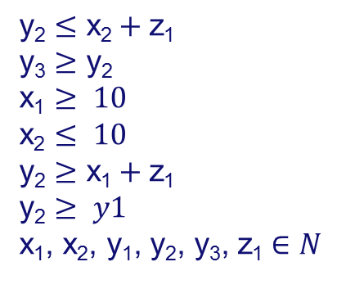
Construction of the ILP problem : converting guards to ILP constraints
Log: S {z=10,y=0} – A{x=1} – C{y=11} – E – A{x=3} – B{y=13} -
Process: S – A – C – E – A – B - F
Process: S {z= z₁,y=y₁} – A{x=x₁} – C{y= y₂} – E – A{x= x₂} – B{y= y₃} - F
Variables: v_{i} = the i-th write operation for variable v
...
$$\text{y}\text{2}≤\text{x}\text{2}+\text{z}\text{1}$$
$$\text{y}\text{3}≥\text{y}\text{2}$$
$$\text{x}\text{1}≥ 10$$
$$\text{x}\text{2}≤ 10$$
$$\text{y}\text{2}≥\text{x}\text{1}+\text{z}\text{1}$$
$$\text{y}\text{2}≥ y1$$
x₁, x₂, y₁, y₂, y₃, z₁$∈N$
y >= x+z
E
1
2
1
2
X
x <= 10 and y’ >=y
Z
B
y <= x+z
S
A
F
Y
C
2
2
x >= 10 and y’ >= y

Slide 13
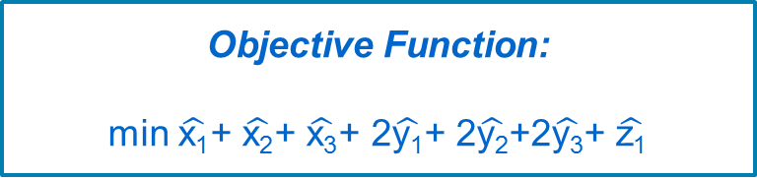
Construction of the ILP problem : the objective function
Log: S {z=10,y=0} – A{x=1} – C{y=11} – E – A{x=3} – B{y=13} -
Process: S {z= z₁,y=y₁} – A{x=x₁} – C{y= y₂} – E – A{x= x₂} – B{y= y₃} - F
Additional variables: $\hat{\text{v}\text{i}}=\left\{\begin{matrix}0 & \text{if} \text{value} \text{assigned} \text{to} \text{v}\text{i} \text{is} \text{the} \text{same} \text{as} \text{in} \text{the} \text{corresponding} \text{log} \text{event} \\ 1 & otherwise\end{matrix}\right.$
E.g., for the first write operation for x: $\hat{\text{x}\text{1}}=0\overset{⇔}{}\text{x}\text{1}=1$
Objective Function:
min $\hat{\text{x}\text{1}}$+ $\hat{\text{x}\text{2}}$+ $\hat{\text{x}\text{3}}$+ 2$\hat{\text{y}\text{1}}$+ 2$\hat{\text{y}\text{2}}$+2$\hat{\text{y}\text{3}}$+ $\hat{\text{z}\text{1}}$
y >= x+z
E
1
2
1
2
X
x <= 10 and y’ >=y
Z
B
y <= x+z
S
A
F
Y
C
2
2
x >= 10 and y’ >= y

Slide 14
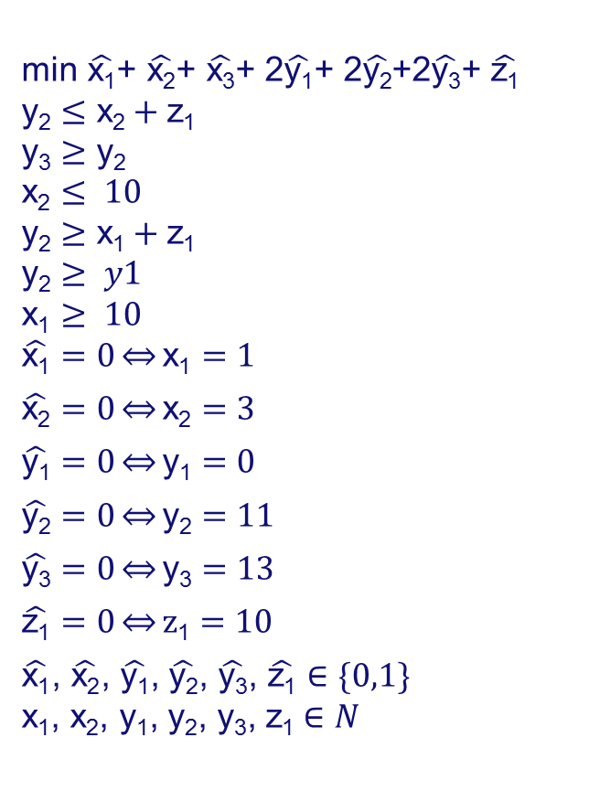
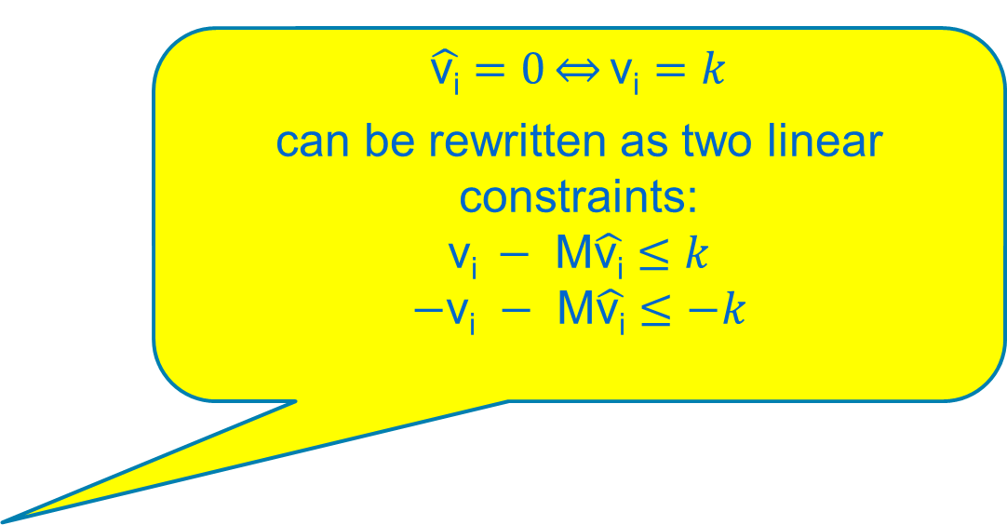

Construction of the ILP problem : converting guards to constraints
Log: S {z=10,y=0} – A{x=1} – C{y=11} – E – A{x=3} – B{y=13} -
Process: S {z= z₁,y=y₁} – A{x=x₁} – C{y= y₂} – E – A{x= x₂} – B{y= y₃} - F
$$\text{min} \hat{\text{x}\text{1}}\text{+ }\hat{\text{x}\text{2}}\text{+ }\hat{\text{x}\text{3}}\text{+ 2}\hat{\text{y}\text{1}}\text{+ 2}\hat{\text{y}\text{2}}\text{+2}\hat{\text{y}\text{3}}\text{+ }\hat{\text{z}\text{1}}$$
$$\text{y}\text{2}≤\text{x}\text{2}+\text{z}\text{1}$$
$$\text{y}\text{3}≥\text{y}\text{2}$$
$$\text{x}\text{2}≤ 10$$
$$\text{y}\text{2}≥\text{x}\text{1}+\text{z}\text{1}$$
$$\text{y}\text{2}≥ y1$$
$$\text{x}\text{1}≥ 10$$
$$\hat{\text{x}\text{1}}=0\overset{⇔}{}\text{x}\text{1}=1$$
$$\hat{\text{x}\text{2}}=0\overset{⇔}{}\text{x}\text{2}=3$$
$$\hat{\text{y}\text{1}}=0\overset{⇔}{}\text{y}\text{1}=0$$
$$\hat{\text{y}\text{2}}=0\overset{⇔}{}\text{y}\text{2}=11$$
$$\hat{\text{y}\text{3}}=0\overset{⇔}{}\text{y}\text{3}=13$$
$$\hat{\text{z}\text{1}}=0\overset{⇔}{}\text{z}\text{1}=10$$
$\hat{\text{x}\text{1}}$, $\hat{\text{x}\text{2}}$, $\hat{\text{y}\text{1}}$, $\hat{\text{y}\text{2}}$, $\hat{\text{y}\text{3}}$, $\hat{\text{z}\text{1}}∈\{0,1\}$
x₁, x₂, y₁, y₂, y₃, z₁$∈N$
$\hat{\text{v}\text{i}}=0\overset{⇔}{}\text{v}\text{i}=k$
can be rewritten as two linear constraints:
$$\text{v}\text{i} − \text{M}\hat{\text{v}\text{i}}≤k$$
$$−\text{v}\text{i} − \text{M}\hat{\text{v}\text{i}}≤−k$$
Optimal Solution:
$$\text{x}\text{1}=1;\text{x}\text{2}=3$$
$$\text{z}\text{1}=1\text{y}\text{1}=0;\text{y}\text{2}=11;\text{y}\text{3}=13$$
$$\hat{\text{x}\text{1}}=1;\hat{\text{x}\text{2}}=0$$
$$\hat{\text{y}\text{1}}=0;\hat{\text{y}\text{2}}=0;\hat{\text{y}\text{3}}=0$$
$$\hat{\text{z}\text{1}}=1$$
Alignment cost=
  Value Objective Function at minimum
  +
  Cost of Log/Process Move=2+2

Slide 15
Additional features
Support for the OR operator in the transition guards
Support for any time of primitive types (through a bidirectional conversion to numerical value):
  Boolean
  Timestamp
  String

Slide 16
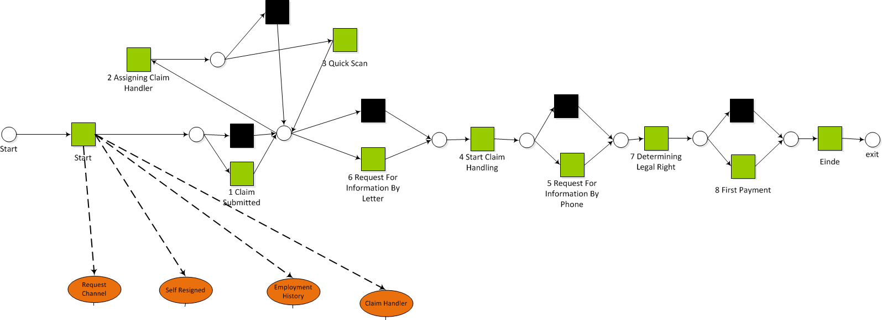
Implementation and Experiments
Implemented as ProM plugins
Tested with a real-life event log
  The event log recorded the execution of 12319 process cases with a Dutch insurance institute
  The process model was generated using the new ProM Decision Miner [2]
[2] Massimiliano de Leoni, Wil M. P. van der Aalst: Data-aware process mining: discovering decisions in processes using alignments. 28th Annual ACM Symposium on Applied Computing (SAC '13)

Slide 17
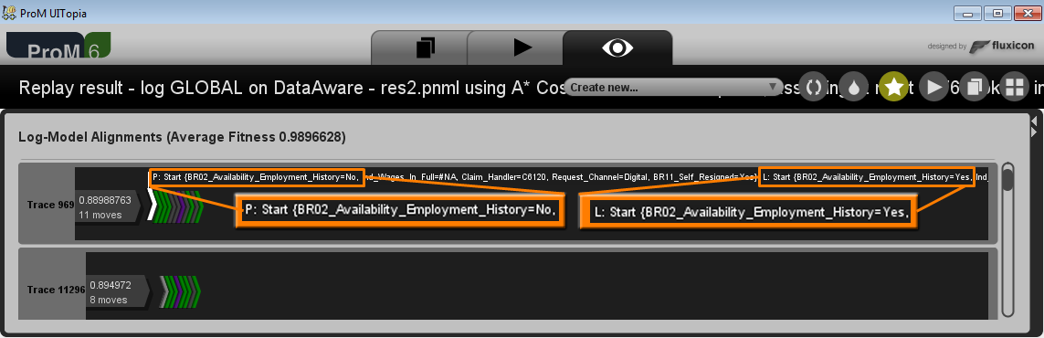
Visualization of the optimal alignments in ProM
Each row is the optimal alignment of a different log trace
Alignments are visualized a sequence of triangles
  Each triangle corresponds to a move
  The type of move is identified by the colour
    Green: move in both with correct write operations
    White: move in both with incorrect write operations
    Purple: move in model; Yellow: move in log

Slide 18
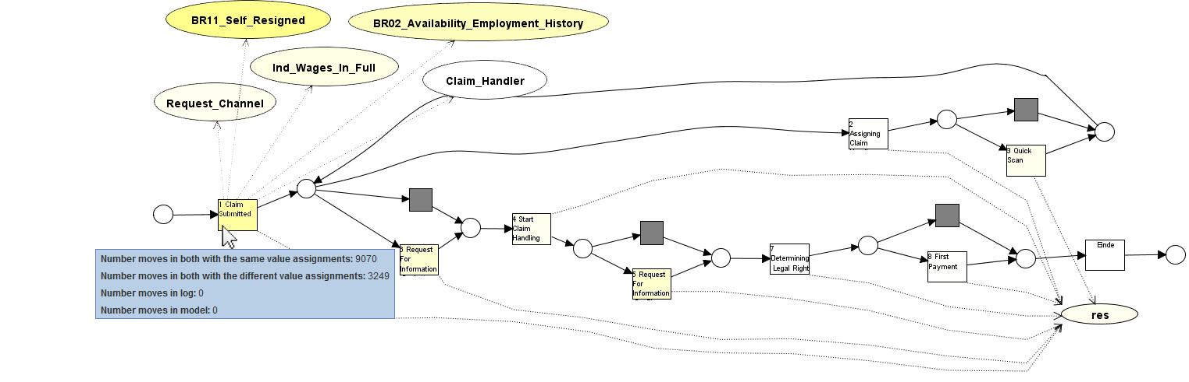
A Helicopter view on the optimal alignments : projection onto models
When there are so many alignments (12319), difficult to gain a general insight into the most common problems
We also provide a visualization where alignments are projected onto the model
  Darker colour for activities/variables more involved into deviations

Slide 19
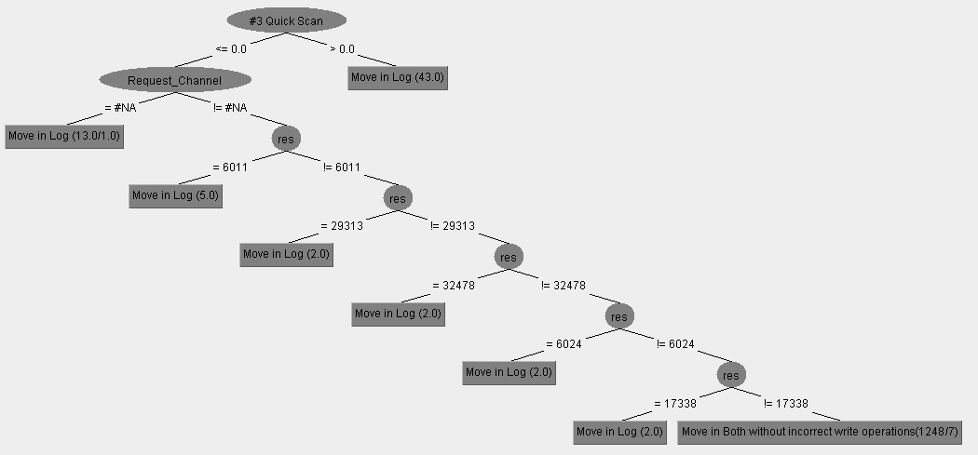
A Helicopter view on the optimal alignments : root causes of deviations
Transitions are associated with decision trees:
  Features: Process Variables + #execution of transitions in the prefix
  Classification Attribute: The move types (in log, model, etc.)

Slide 20
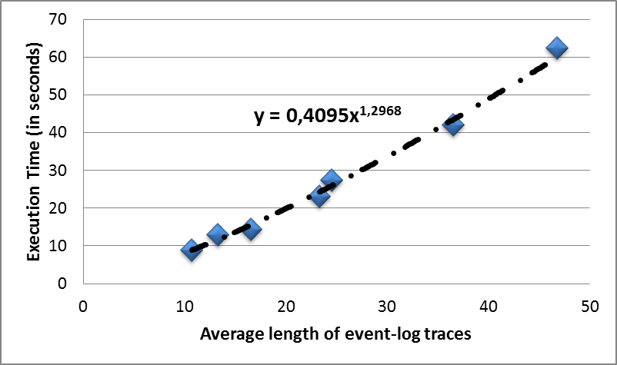
Execution-Time Analysis

Slide 21
?

